Slide 1


Predicting Employee Attrition

Slide 2
Assignment: AI & ML Role - Python Programming
Objective : This assignment aims to assess my proficiency in Python programming and my understanding of fundamental concepts in artificial intelligence (AI) and machine learning (ML).

Slide 3
Highlighting The Key Steps :
Dataset analysis: understand the structure and features of the IBM HR analytics employee attrition & performance dataset.
Data preprocessing: handle missing values, encode categorical variables, and scale numerical features if necessary.
Model development: split the dataset into training and testing sets. Choose suitable machine learning algorithms for binary classification.
Model training: implement the selected algorithm(s) using python libraries like scikit-learn or pytorch. Train the model(s) on the training data.

Slide 4
Model Evaluation: Evaluate the performance of the trained model(s) using metrics such as accuracy, precision, recall, and f1-score.
Model Optimization: Explore techniques for model optimization, such as hyperparameter tuning, feature selection, or model ensemble methods, to improve performance.
Optimization Impact Analysis: Optimize the model parameters and evaluate the impact on model performance.

Slide 5
Data Collection
Flowchart Steps
Data Analysis
Data Preprocessing
Documentation And Presentation
Model Development
Model Optimization
Model Evaluation

Slide 6
Algorithms Used :
Support Vector Machine (SVM): A supervised learning algorithm that analyzes data for classification and regression analysis. SVM separates data points into different classes by finding the hyperplane that maximizes the margin between classes.
XGBoost Classifier: An implementation of gradient boosted decision trees designed for speed and performance. It sequentially builds multiple decision trees to correct the errors of the previous model, resulting in a powerful ensemble model.
K-Nearest Neighbors (KNN) Classifier: A simple, instance-based learning algorithm used for classification and regression tasks. KNN classifies data points based on the majority class of their k nearest neighbors, where k is a predefined number of neighbors.

Slide 7
Random Forest Classifier: An ensemble learning method that constructs multiple decision trees during training and outputs the mode of the classes (classification) or the mean prediction (regression) of the individual trees.
Logistic Regression: Despite its name, logistic regression is a linear model for binary classification that predicts the probability of a binary outcome based on one or more predictor variables.

Slide 8
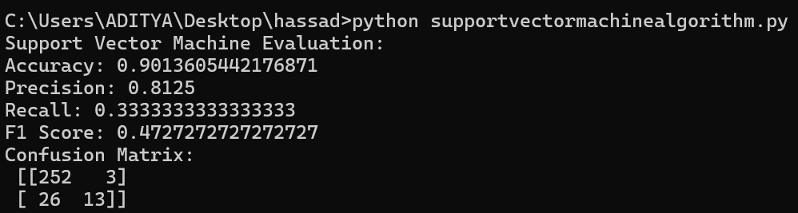
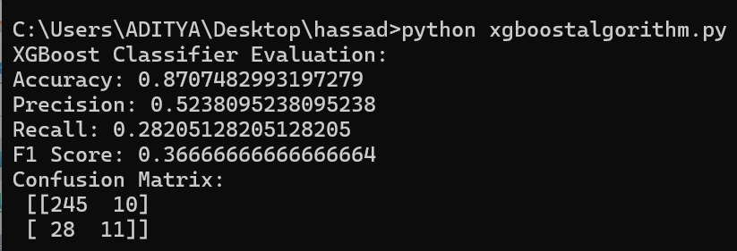
Results Acquired After Using Every Algorithm :
SVM Algorithm Result
Xgboostalgorithm Result

Slide 9
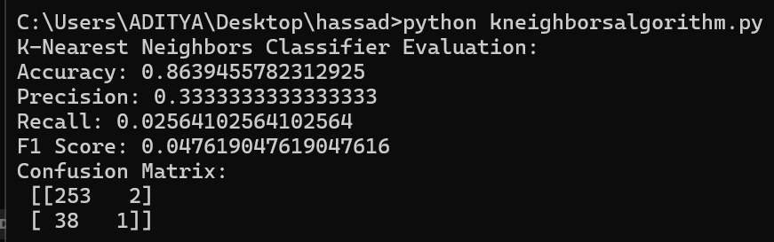
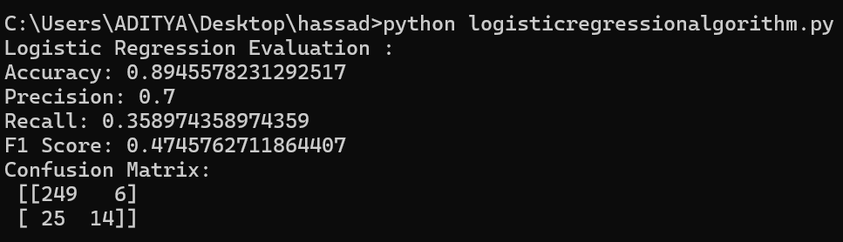
K Neighbors Algorithm Result
Logistic Regression Algorithm Result

Slide 10
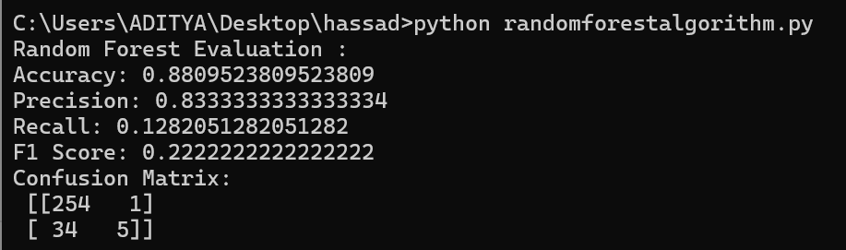
Random Forest Algorithm Result

Slide 11
Conclusions :
The assignment on predicting employee attrition highlights the significance of leveraging machine learning techniques in HR analytics. Through data analysis, preprocessing, model development, and optimization, valuable insights can be gained to understand factors contributing to employee turnover. By evaluating various machine learning algorithms and optimizing model performance, organizations can enhance their ability to predict and mitigate employee attrition, ultimately fostering a more stable and productive workforce.

